Slide 1
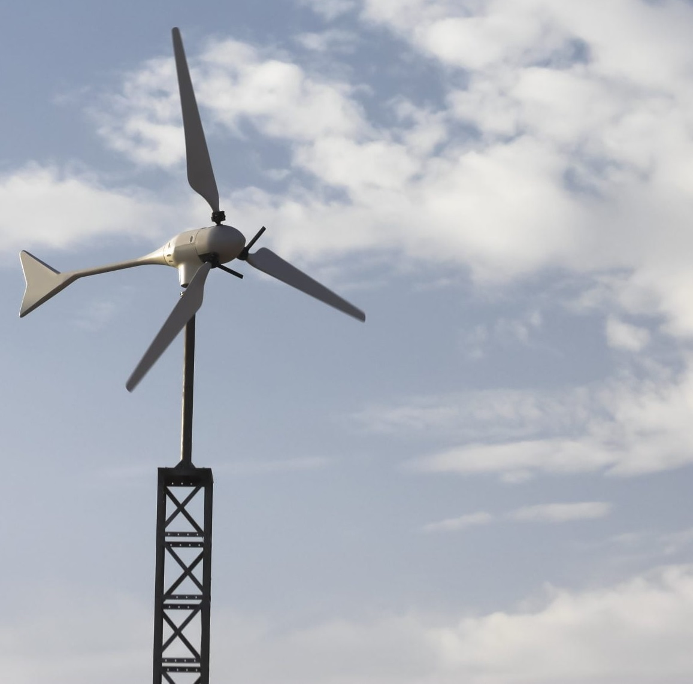

Team 7:
Wind-Powered Building
Team Members:
Colton, Reginald, Maxwell, Peter
Sponsor: Dr. Jang TA: Rohith Ramanujam Kumar
4th Status Update
Notes:
https://www.ryse.energy/3kw-wind-turbines/#iLightbox[gallery_image_1]/11

Slide 2
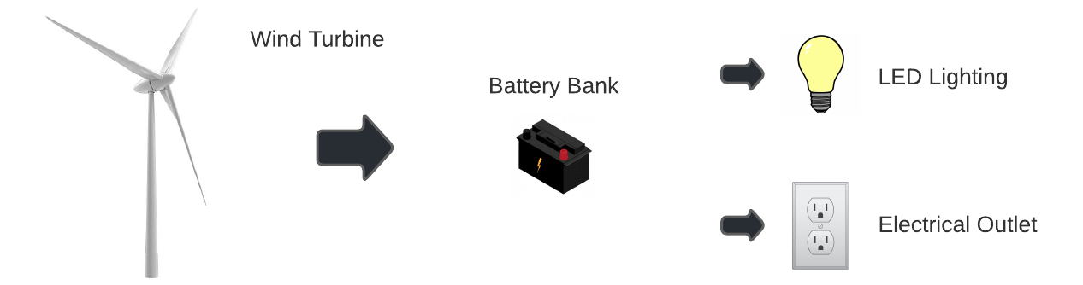
Project Summary
Implementing local renewable power generation to reduce reliance on fossil fuels
Using a wind turbine to capture energy, store it in batteries, and power AC and DC loads

Slide 3
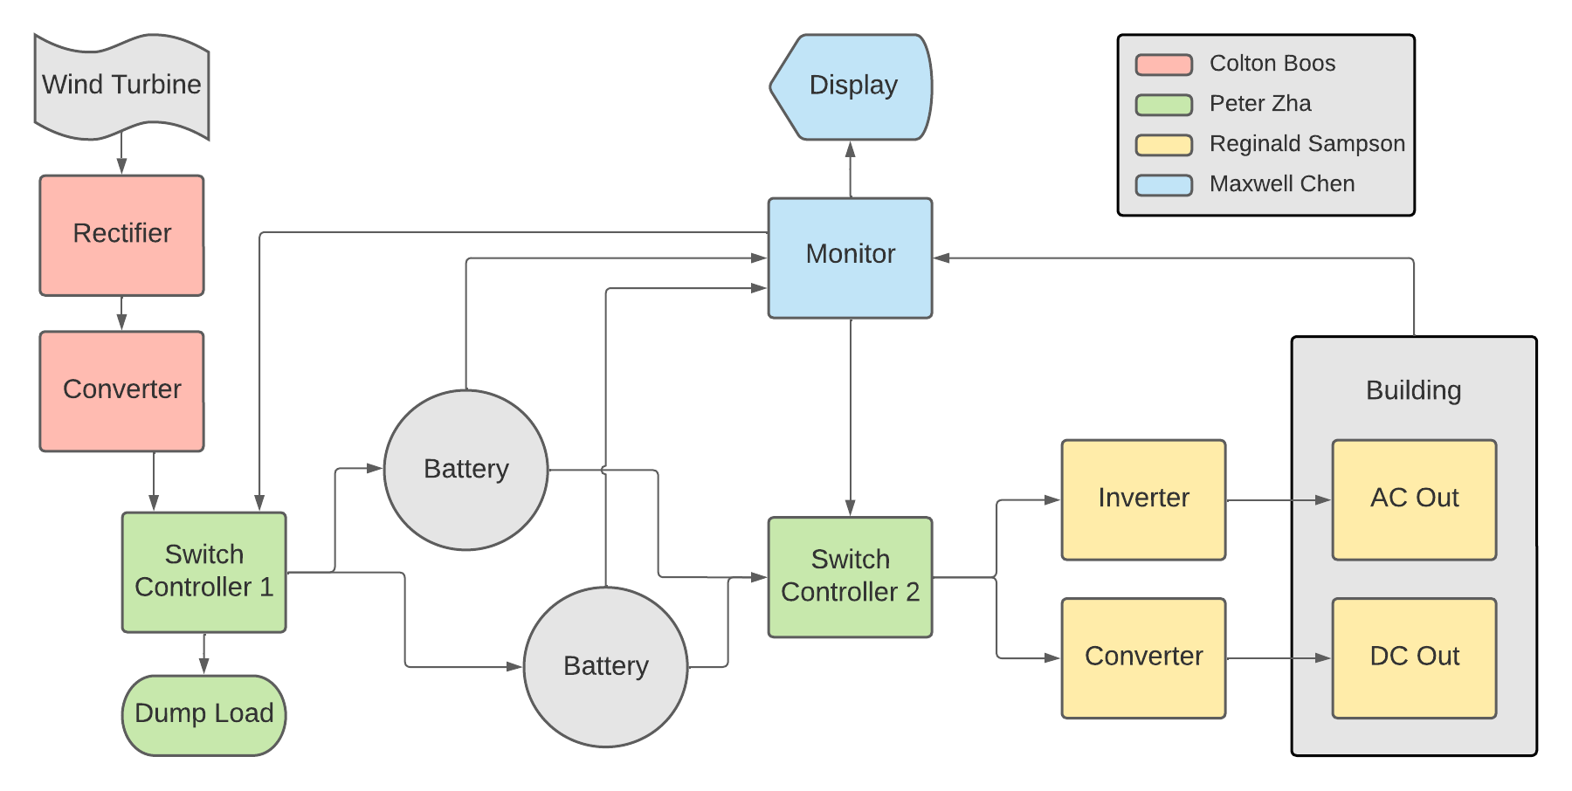
Block Diagram and Task Partition

Slide 4
Project Timeline
Early September
Late September
Early October
Late October
Early November
Mid November
Refine Subsystems
Begin Integration
Continue Integration
Continue Integration and Validation
Complete Validation
Final report and presentation
Ensure subsystems are in a working state and simulations are done.
Resolve any subsystem issues left over from the previous semester.
All subsystems should be in complete working order with PCBs on the way.
Begin integrating rectifier with boost converter.
All other PCBs should be ordered and ready to integrate.
Integrate Switch controllers with monitor subsystem.
Integration of Rectification and Conversion Subsystem with Switch Controller 1
Integration of Inversion and Conversion Subsystem with Switch Controller 2
Validation of full system
Complete final report and prepare for final presentation.
Done
In Progress
Behind Schedule
Not Started

Slide 5
Rectification and Conversion Subsystem
Owner: Colton Boos
Accomplishments since last review 12 hours of effort | Ongoing progress/problems and plans until the next presentation
Integrated with switch controller 1 Validated rectifier up to 5V for now Validated converter with 14.8V output and measured current draw | Correlate wind speed with output voltage of turbine Finish validating rectifier with wind turbine as input for above 5V

Slide 6
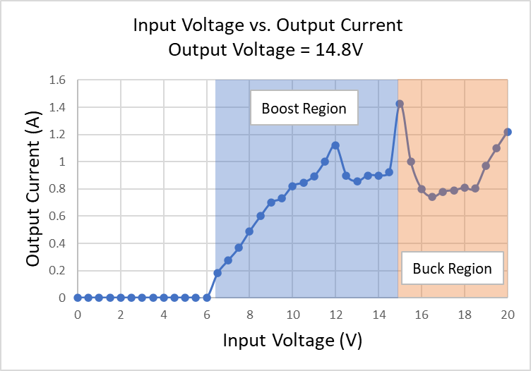
Rectification and Conversion Subsystem
Owner: Colton Boos
Buck-Boost Converter Validation
Input voltage represents the output of the rectifier
Using constant voltage charging at 14.8V
The output current will be applied to the battery for charging
Minimum input voltage for battery charging is 6.5V

Slide 7
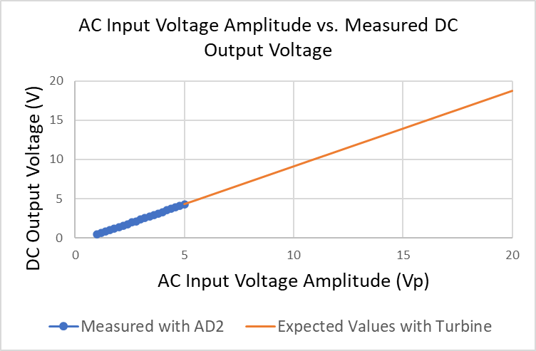
Rectification and Conversion Subsystem
Owner: Colton Boos
Three-Phase Rectifier Validation (In Progress)
Only able to test up to 5V AC
The rest must be done with wind turbine
So far the results show a linear relationship with V_{DC} = 0.85V_{AC}

Slide 8
Switch Controller Subsystem
Owner: Peter Zha
Accomplishments since last review 15 hours of effort | Ongoing progress/problems and plans until the next presentation
Validating PCBs - open circuit voltage and short circuit current Primary focus on Switch 1 and integrating with Converter subsystem | Notable voltage drop across each circuit Diodes absolutely necessary, but also contributing to the voltage drop Affects other subsystems

Slide 9
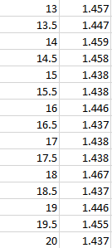
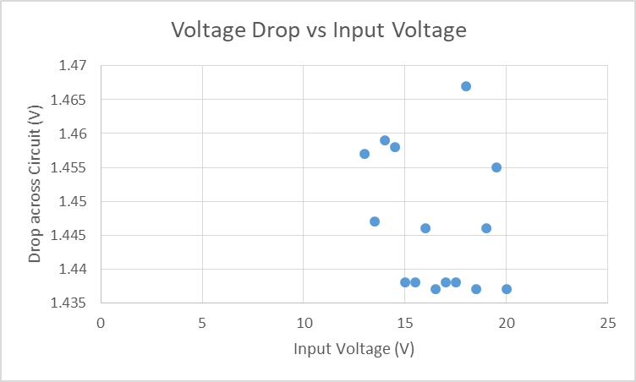
Switch Controller Subsystem
Owner: Peter Zha
Voltage Drop Across Switch 1
Average: 1.44 V

Slide 10
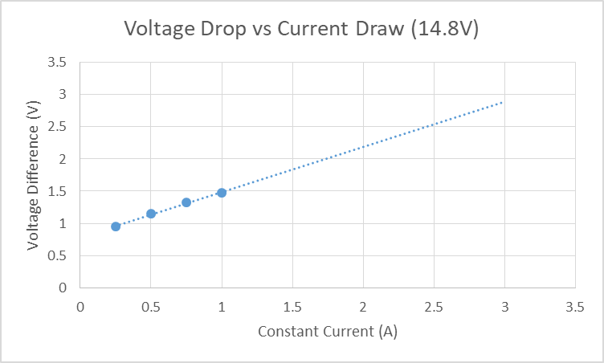
Switch Controller Subsystem
Owner: Peter Zha
Voltage Drop Across Switch 1 with Increasing Current

Slide 11
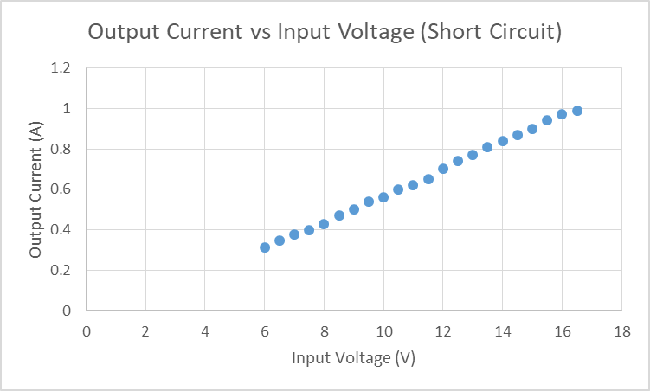
Switch Controller Subsystem
Owner: Peter Zha
Short Circuit Measurement Switch 2 using Constant Resistor Mode

Slide 12
Inversion and Conversion Subsystem
Owner: Reginald Sampson
Accomplishments since last review 12 hours of effort | Ongoing progress/problems and plans until the next presentation
Fixed the Inverter PCB and soldered the inductor Validated converter, inverter and load network PCBs (individually and with loads) Validated inverter with new transformer | Test PCBs with battery Validate PCBs with Peter’s subsystem Determine if a second boost converter is needed

Slide 13
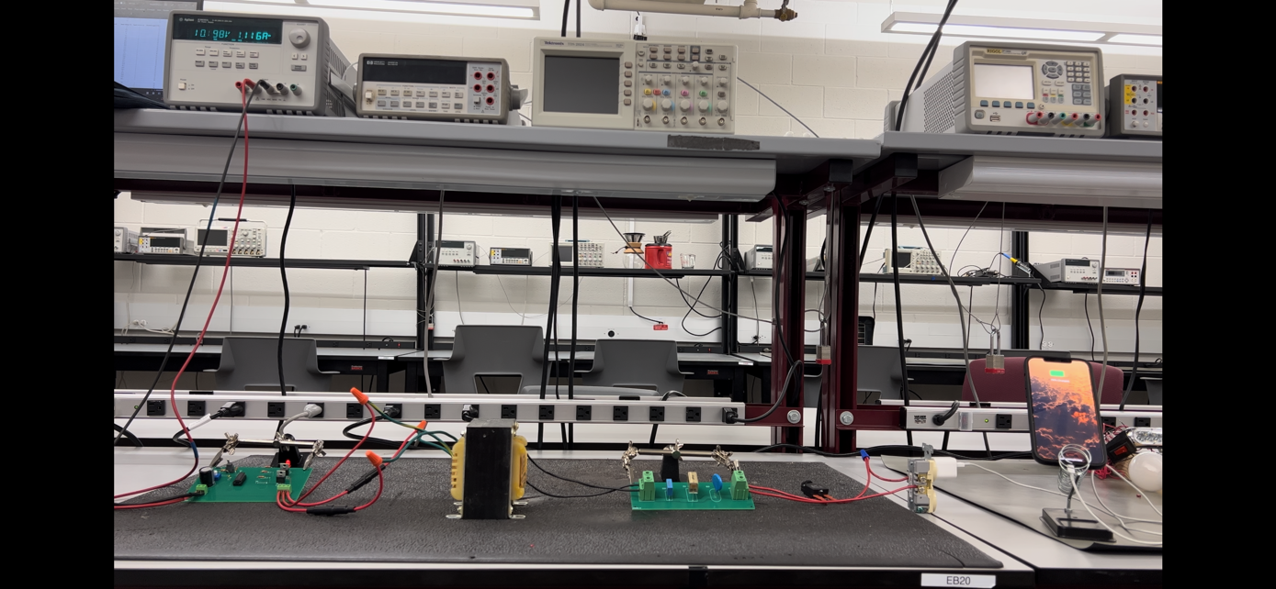
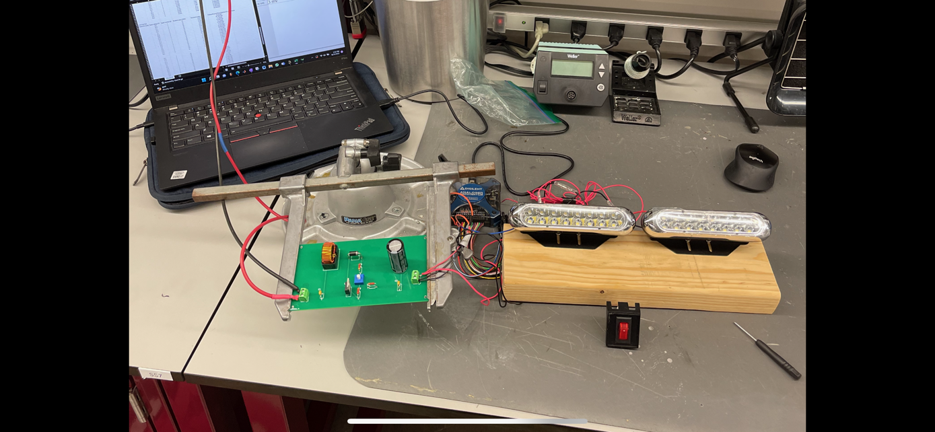
Inversion and Conversion Subsystem
Owner: Reginald Sampson
Inverter + Load Network + Load
Converter + Load

Slide 14
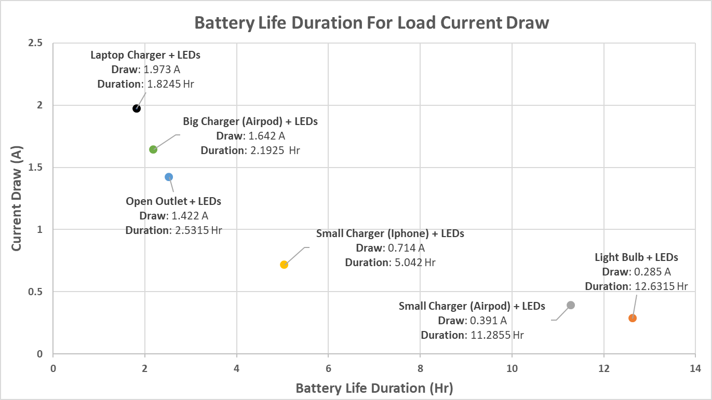
Inversion and Conversion Subsystem
Owner: Reginald Sampson
50% of total battery capacity used
3.6 Ah capacity
Sum of current draw from LEDs and varying outlet loads.
Current draw of inverter loads found at 13.5VDC input
Current draw of LEDs found at 11.7VDC input

Slide 15
Monitor Subsystem
Owner: Maxwell Chen
Accomplishments since last review 15 hours of effort | Ongoing progress/problems and plans until the next presentation
Fixed issues with sensor readings Discussed with sponsor on what to change and what to improve Starting progress of website improvement | Addition of a graph into the website is imposing trouble with more files needed to be uploaded onto the esp32 Continue progress on website and integration with the Switch Controller subsystem

Slide 16
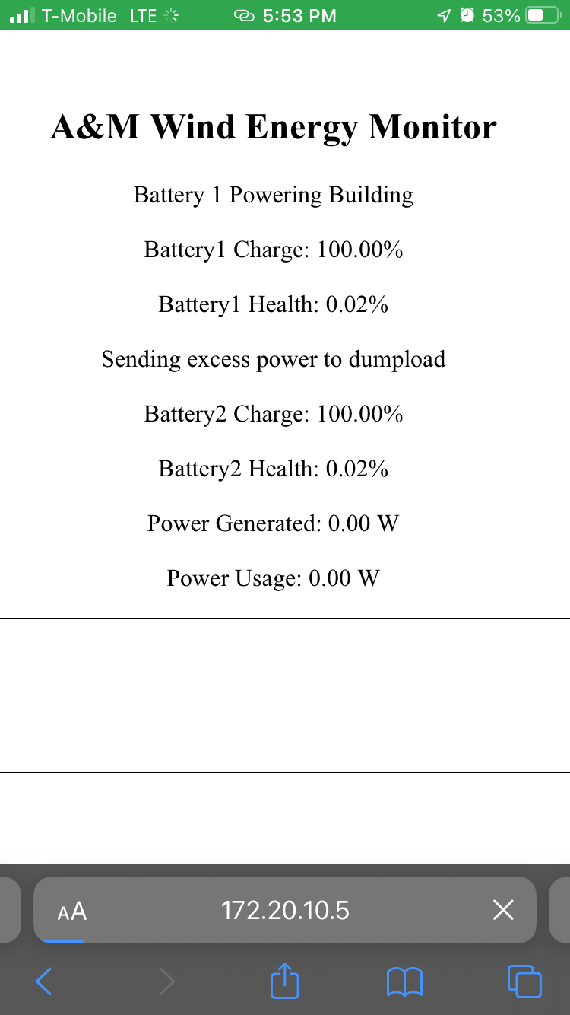
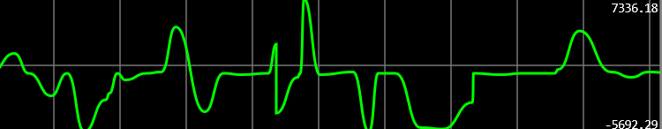
Monitor Subsystem
Owner: Maxwell Chen
Serial Peripheral Interface Flash File System (SPIFFS)
Arduino WifiServer vs EspAsyncServer
May need changes to way website functions internally

Slide 17
Parts Ordering Status
Part Description | Status(Order Approved/ Order Placed/ Part Received
HiLetGo Voltage Sensor | Parts Received
INA219 Current Sensor | Parts Received
Power MOSFETs | Parts Received
Rectifier PCB | Parts Received
Converter (Colton) PCB | Parts Received
Inverter PCB | Parts Received
Converter (Reggie) PCB | Parts Received
Switch Controller PCBs | Parts Received

Slide 18
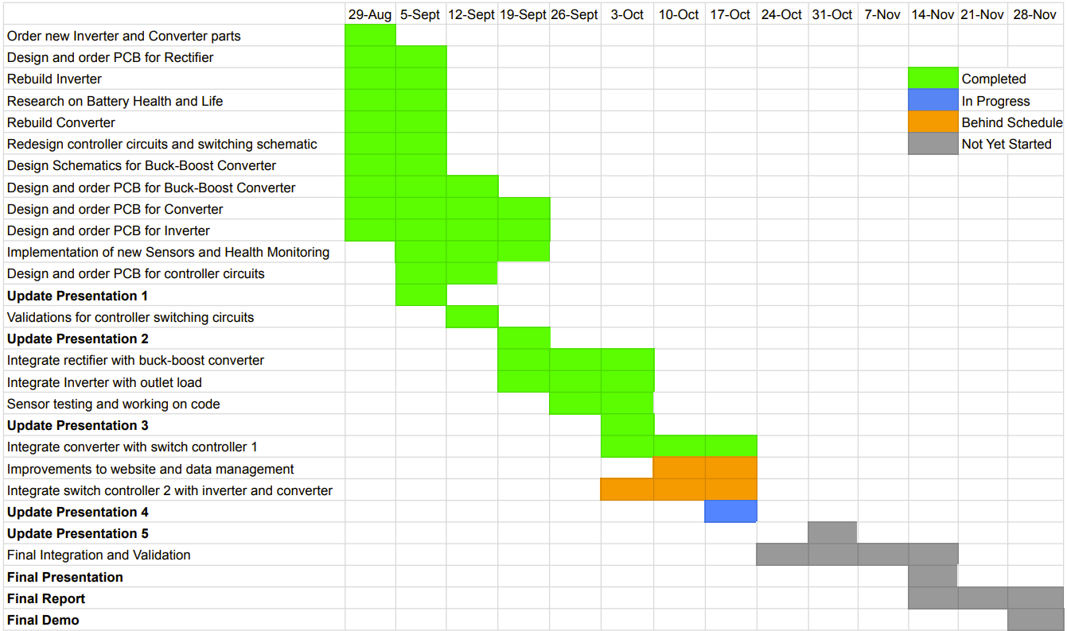
Execution Plan

Slide 19
Validation Plan
Responsible Engineer(s) | Test Name | Validation Requirements | Methodology | Status
Reggie | DC-AC Conversion Test | 12VDC is converted to 12VAC | Input DC voltage to the inverter and measure the output AC voltage before the transformer (with the transformer disconnected) | Completed
Reggie | Transformer Step-up Test | Transformer output is 120VAC given 24VAC input | Input DC voltage to the inverter and measure the output AC voltage of the transformer using a digital multimeter | Completed
Reggie | Inverter Output Test | Connected outlet outputs 120VAC and powers a load | Input DC voltage to the inverter and measure the output AC voltage of the transformer using a digital multimeter and plug in an iphone charger to the outlet | Completed
Reggie | Converter with battery | Circuit elements function properly with battery voltage | Input DC voltage to the converter and measure the output DC voltage before the LEDs (with LEDs disconnected) | In Progress
Reggie | Converter Output | Converter output powers LED lights | Input DC voltage to the converter with the LEDs connected | Completed
Colton | AC-DC Conversion Test | 2-20VAC is rectified to corresponding DC with < 0.1 V output ripple | Input 3 phase AC voltages and measure corresponding output | In Progress
Colton | DC-DC Conversion Test | 6-20VDC is converted to set DC voltage | Input various DC voltages and measure corresponding output | Completed

Slide 20
Validation Plan
Responsible Engineer(s) | Test Name | Validation Requirements | Methodology | Status
Colton | Rectifier and Converter Connection Test | Voltage outputs to set DC voltage | Input 3 phase AC voltage to rectifier and measure output DC voltage of converter | Completed
Peter, Colton & Max | Charge Batteries Test | Wind-Power is correctly charging the battery bank with appropriate switching maneuvers | Use wind-turbine to output power, measure if battery capacity has gone up | In Progress
Peter, Reggie & Max | Power Output Test | Battery bank is used to power the load with appropriate switching maneuvers | Measure voltage and current at output when switching battery outputs and determine if power transition is seamless | Untested
Peter | Input/Output Test | Correctly measures 13 V at output of switch | Measure voltage and current at the load of the switch and compare with expected current and voltage values | In Progress
Peter | Switch Validation | The switch correctly switches between outputs | Input signals from microcontroller and test combination of expected inputs/outputs and verify with voltage and current measurements | In Progress
Maxwell | Battery Capacity Monitor | System is able to successfully track the capacity of the battery | Inputing a voltage and current source into the system or by testing with the actual batteries to see if it can accurately track how much charge is left | In Progress

Slide 21
Validation Plan
Responsible Engineer(s) | Test Name | Validation Requirements | Methodology | Status
Maxwell | Display Power Generated and Power Usage | System is able to display the power generated from the Wind Turbine, and the power used by the building | Similar to the battery capacity portion there needs to be a voltage and current source to test if this portion is working correctly. | In Progress
Maxwell | Display Battery Health | System will be able to calculate the battery health each battery and display this information to the user allowing them to know if they should replace the battery soon or not | Similar to the battery capacity portion there will need to be a current source to replicate the usage and flow of charge through a battery and seeing if it is able to accurately calculate the health of said battery. | In Progress
Maxwell | Website for System Monitoring | Website is accessible and cleanly displays information about the entire system | Once other parts of the systems are setup the website should be able to correctly display information to the user | In Progress
Maxwell | Output Signal for Switch Controller | System will have triggers for specific cases of when each battery should be used or charged. | Once connected with the charge and switch controller check that the system is correctly outputting signals to the controller and that the controller is performing the correct result | Untested
Full Team | Full System Test | Wind-Power is used to charge the battery bank, Monitor sends signals to switching circuits, switch controller outputs correct path, battery power is used by inverter and converter to power the load | Charging: Input power from wind turbine and signals from MCU, then measure and compare voltage and current. Discharging: Power laptop charger and phone charger, verify with voltage and current measurements | Untested

Slide 22
Thank you for listening
Any Questions?
Notes:
https://www.ryse.energy/3kw-wind-turbines/#iLightbox[gallery_image_1]/11

